Slide 1
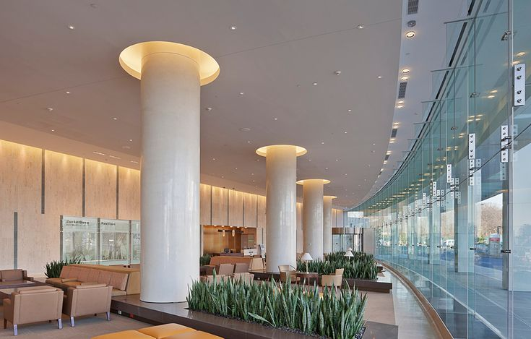

DESIGN AND LAYOUT OF INPATIENT CARE
CHRISTYANA. A
RA2352010010003
MBA HEALTHCARE AND HOSPITAL MANAGEMENT
01

Slide 2
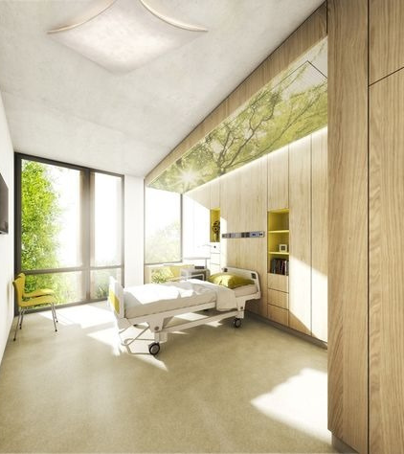
INTRODUCTION
1.1 Definition
Inpatient design and layout: Physical planning of healthcare facilities for overnight care.
Inpatient care: Medical and nursing services for hospitalized patients.
1.1.2 Importance
Safety and comfort: Prevents falls, infections, and promotes privacy.
Efficient workflow: Reduces time for care and improves efficiency.
Operational efficiency: Optimizes resource utilization and costs.
Positive patient experience: Contributes to satisfaction and outcomes.
02

Slide 3
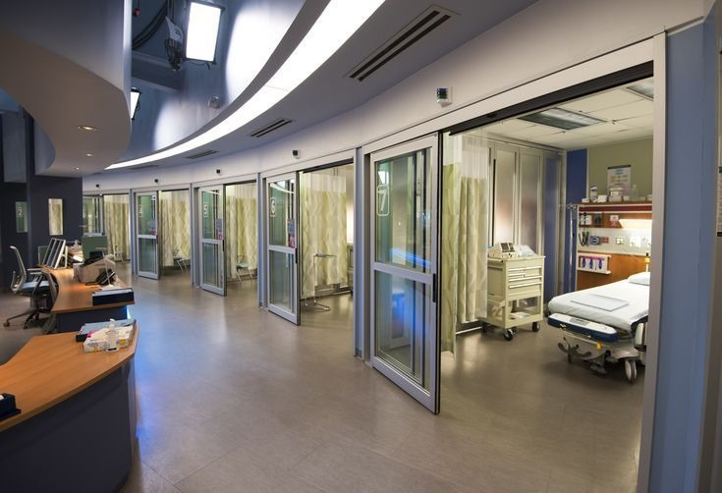
2. FACTORS INFLUENCING DESIGN AND LAYOUT
Patient Safety and Comfort
Infection control
Fall prevention
Privacy and dignity
Noise reduction
Wayfinding
2.1
Staff Efficiency and Workflow
Centralized nursing stations
Efficient work zones
Adequate storage
Ergonomic design
Support spaces
2.2
02
Cost and Resource Management
Importance: Reduces operational costs, improves efficiency, and promotes sustainability.
Recommendations: Flexible spaces, energy efficiency, sustainable materials, waste management, centralized utilities.
01
2.3
04

Slide 4
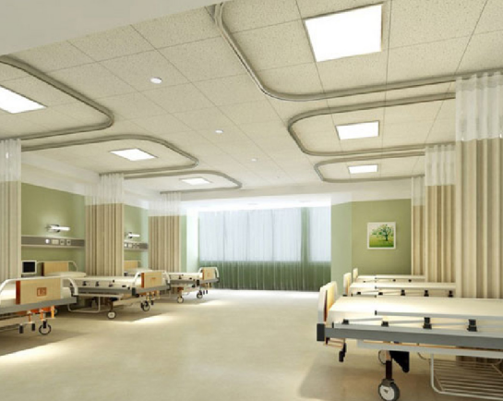
3. DESIGN AND LAYOUT ELEMENTS
3.1 Room Design
Bed Placement: Beds should be positioned away from windows and doors to minimize drafts and noise.
Space Requirements: Adequate space around beds is essential for patient care and mobility.
Lighting: Natural light and adjustable artificial lighting should be provided to create a comfortable and calming environment.
Sound Considerations: Soundproofing materials and quiet zones should be incorporated to minimize noise disturbances.
02
Privacy and Security: Private rooms or curtained-off areas, along with secure storage for personal belongings, should be provided.
05

Slide 5
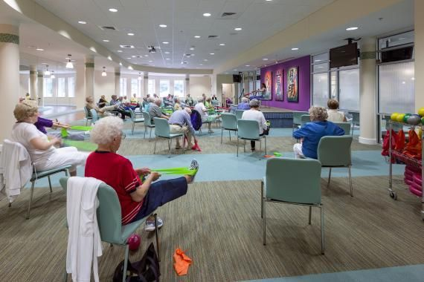
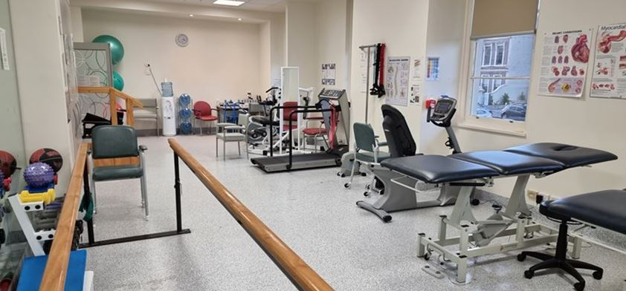
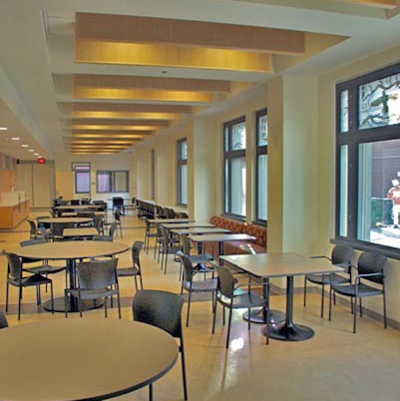
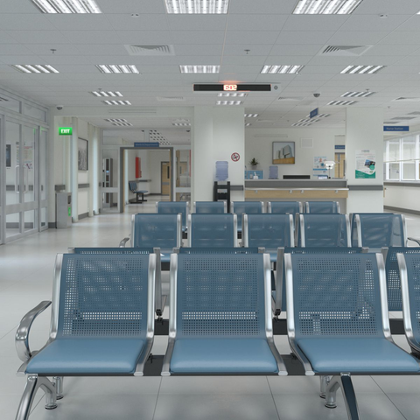
3.2 COMMON AREAS
Waiting Areas: Comfortable seating, adequate lighting, and signage should be provided in waiting areas.
Dining Areas: Dining areas should be spacious, well-lit, and accessible to patients and visitors.
Activity Rooms: Activity rooms should be equipped with appropriate facilities for recreational and therapeutic activities.
06

Slide 6
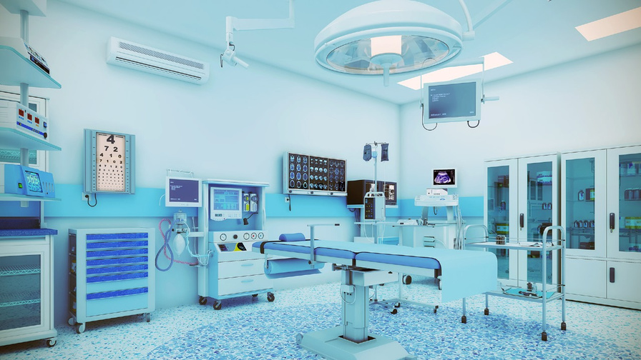
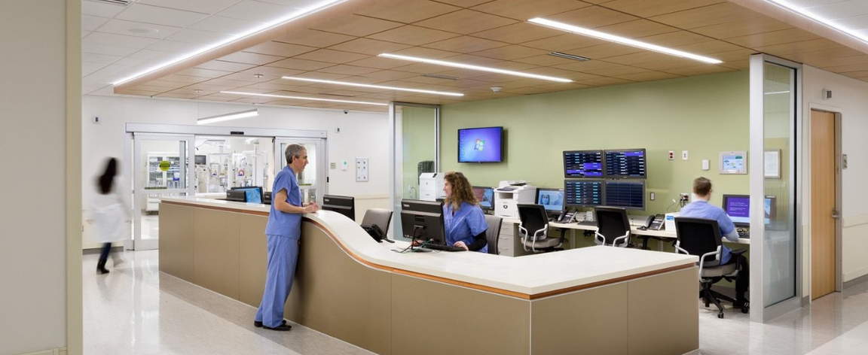
3.3 MEDICAL EQUIPMENT AND TECHNOLOGY
Integration of Medical Equipment:
Design Recommendations:
Medical equipment should be integrated into the design to ensure efficient workflows and patient safety.
Flexibility: Design should accommodate future technological advancements and changes in care delivery.
Accessibility: Equipment and technology should be accessible to healthcare staff and patients with disabilities.
Safety: Safety features should be incorporated to prevent accidents and ensure patient safety.
Interoperability: Equipment and technology should be compatible and interoperable to facilitate data sharing and communication.
Maintenance: Design should facilitate easy maintenance and cleaning of equipment and technology.
07

Slide 7
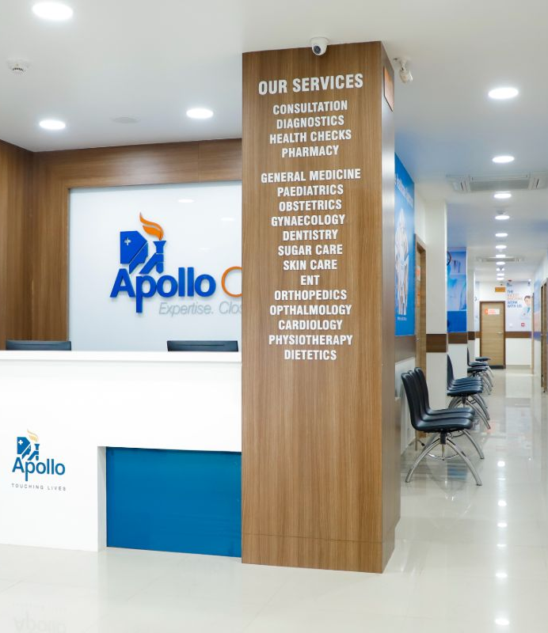
4. CASE STUDY
4.1 Successful Inpatient Design and Layout Case Studies
APOLLO HOSPITALS:
Design Elements:
Centralized nursing stations for efficient communication and monitoring.
Private patient rooms with natural light and calming colors.
Well-equipped and accessible common areas for patients and visitors.
Integration of advanced medical technology.
Patient and Staff Feedback:
Positive feedback from patients on the comfortable and healing environment.
High satisfaction rates among staff due to efficient workflows and supportive facilities.
Improved patient outcomes and shorter length of stay attributed to the effective design.
09

Slide 8
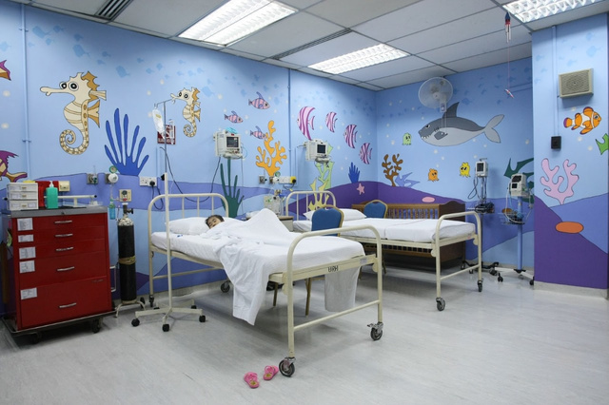
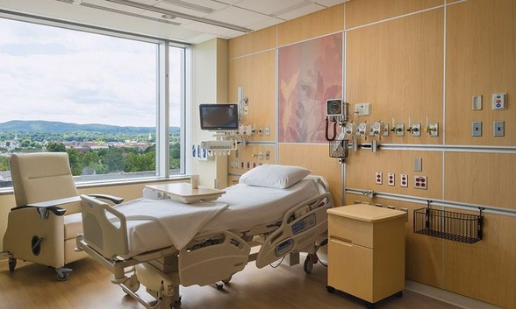
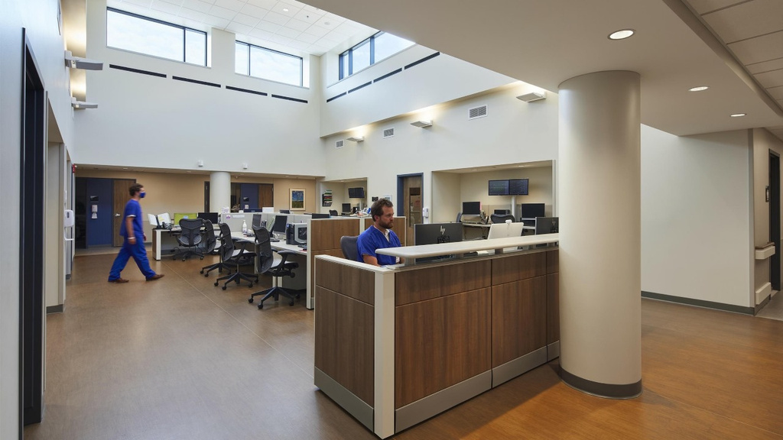
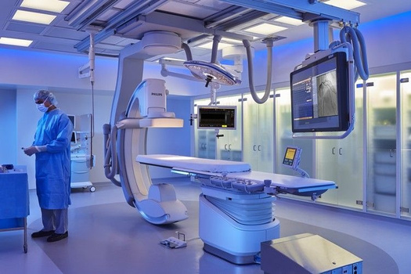
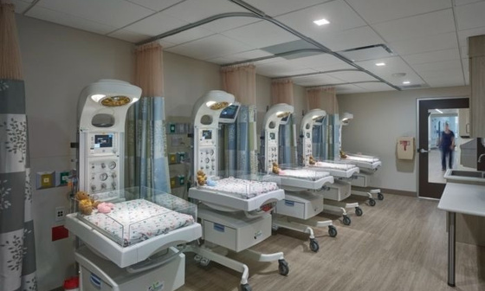
08

Slide 9

5. CONCLUSION
5.1 Summary of Design and Layout Elements
Patient-centered design: Prioritize patient safety, comfort, and privacy.
Efficient workflows: Optimize staff efficiency and communication.
Resource management: Utilize resources effectively and sustainably.
Technological integration: Incorporate advanced medical equipment and technology.
Flexibility: Design for adaptability to future changes and advancements.

Slide 10
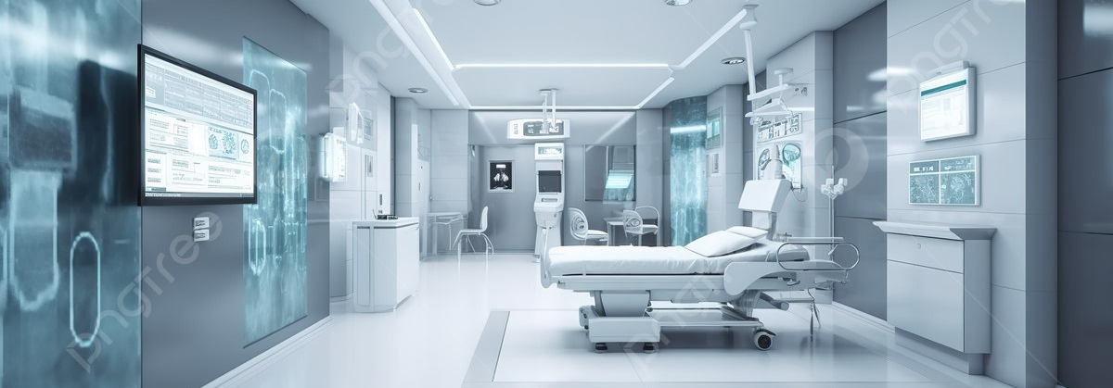
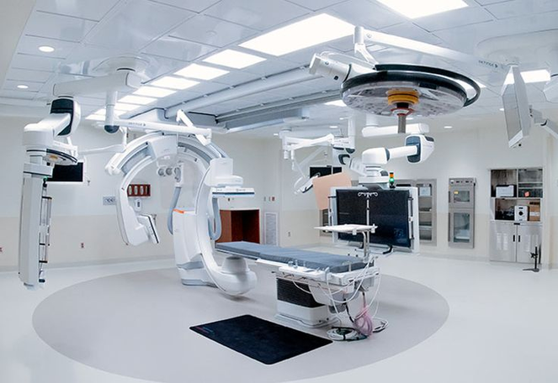
5.2 Future Opportunities for Inpatient Design and Layout Improvement
Personalized design: Tailor design elements to individual patient needs and preferences.
Sustainable design: Incorporate more sustainable materials and practices to reduce environmental impact.
Smart technology: Utilize smart technology to improve patient care, efficiency, and resource management.
Virtual reality and simulation: Explore the use of virtual reality and simulation for training, patient education, and therapeutic purposes.
Collaborative design: Involve patients, staff, and community members in the design process to ensure a patient-centered and inclusive approach.

Slide 11
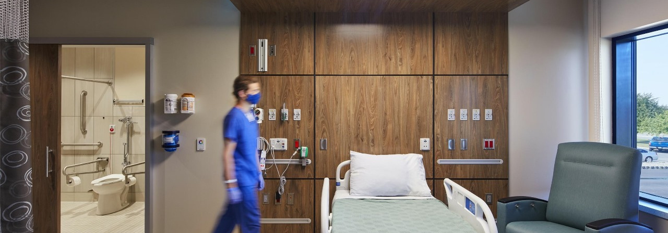
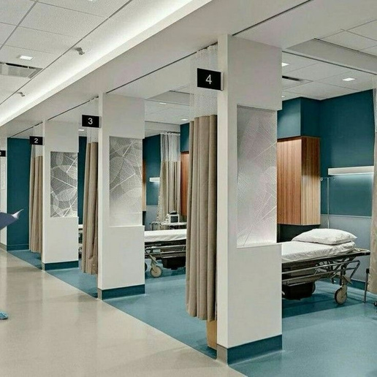
CONCLUSION
Effective inpatient design and layout is essential for providing high-quality care and improving patient outcomes. By prioritizing patient safety, comfort, and efficiency, healthcare facilities can create environments that promote healing and well-being. Future opportunities for improvement include personalized design, sustainable practices, and the integration of advanced technologies.
03

Slide 12
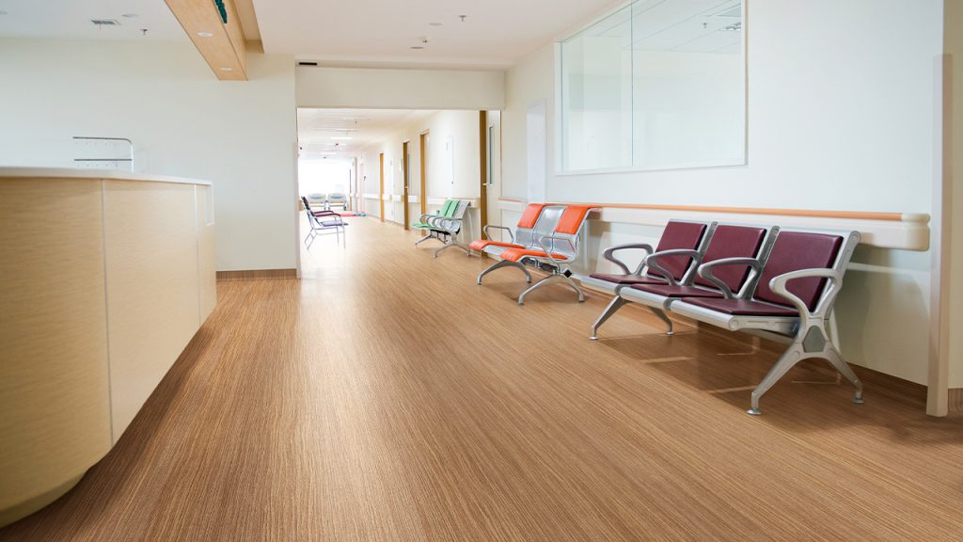
THANK YOU
10

